Slide 1

Agent-based modelling in education
Centre for
Educational Development
Notes:
Welcome to this video about our project on Agent-Based Modeling in Education.
We are Center for Hybrid Intelligence, and one of our focus areas is developing technology-based learning materials for students across educational levels.
The project is funded by Centre for Educational Development.

Slide 2
Agent-Based Modeling: The Virtual Laboratory
Extract relevant data to guide assumptions
Assumptions are used to shape model in NetLogo
The model can now be used for investigations
Notes:
We design so-called agent-based models, a type of computer simulation, which can be thought of as virtual laboratories. We use scientific data and theories to build simulations. These enable students to investigate and test out hypotheses in fields in which carrying out similar investigations in the real world is not possible for some reason, whether it be economical, ethical reasons or practical reasons.
Agent-Based Models make it easy to explore the often unpredictable outcomes in complex phenomena. They let us test our ideas, change assumptions, and slowly build a better understanding of these phenomena.

Slide 3
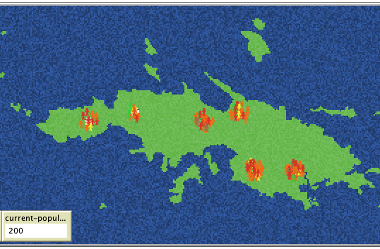
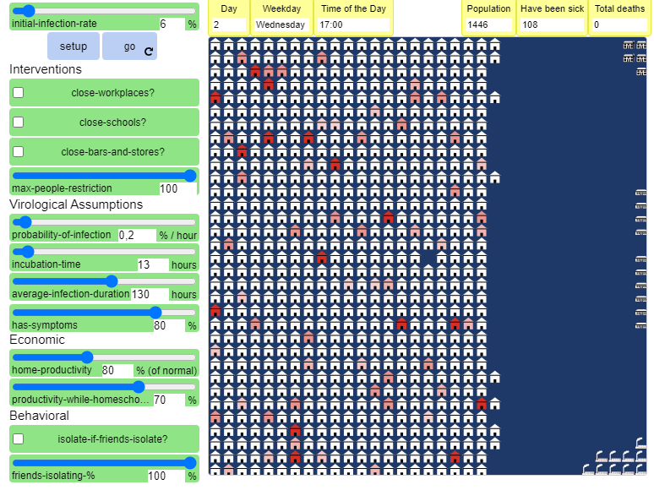
Collaboration Partners
Linguistics with Peter Bakker How do different assumptions affect the linguistic development on St. Thomas during colonization?
Theory of Science with Carsten Bergenholtz How can we strike a balance between a healthy population and a healthy economy during an epidemic?
Notes:
The departments that we have collaborated with so far include linguistics and the department of management.
With Peter Bakker from the linguistics department, we designed a model that explores how a creole (new language) might emerge, when different language-speaking people meet and need to communicate.
With Carsten Bergenholtz from the Department of Management, we made a model that helps students explore the spread of virus in a society during an epidemic. Another and how models can help us make better decisions.
If you are interested in learning more about these models, they are available here on the website.

Slide 4
Upcoming projects
Classical Archeology with Tom Brughmans
On the rise and fall of the roman economy
Department of Management with Michael Zaggl
On the diffusion of innovations in organizations
Notes:
We are currently working with Tom Brughmans from the department of archaeology to build an educational model of the rise and fall of the roman economy. And in collaboration with Michael Zaggl from the Department of Management, we are building an educational model for students to explore the diffusion of innovations in organizations.

Slide 5
Contact information
Arthur Hjorth // head of the team doing agent-based modeling
arthur@mgmt.au.dk
Center for Hybrid Intelligence
mgmt.au.dk/center-for-hybrid-intelligence/
sherson@mgmt.au.dk
Centre for Educational Development
ced.au.dk
ced@au.dk
Notes:
If you are curious about how we use this to build fun and engaging learning activities for students, we go into more depth in the videos [below/ link link].
And if you are curious about using agent-based models in your own teaching, please do not hesitate to get in touch! You can also get more information about agent-based models and how it can be used in teaching on the digital curriculum [insert link to correct page here].

Slide 6
Centre for
Educational Development
Notes:
If you are curious about how we use this to build fun and engaging learning activities for students, we go into more depth in the videos [below/ link link].
And if you are curious about using agent-based models in your own teaching, please do not hesitate to get in touch! You can also get more information about agent-based models and how it can be used in teaching on the digital curriculum [insert link to correct page here].

